Slide 1
AI-Based Industrial Maintenance and Process Optimization
An AI-powered system for predicting machine failures and optimizing industrial maintenance decisions

Slide 2
Problem Statement
Problems:
Traditional maintenance approaches often depend on:
Fixed maintenance schedules
Manual inspection
Reactive maintenance after machine failure
Large amounts of sensor data that are difficult to interpret manually
Consequences
Unexpected machine downtime
Increased maintenance cost
Production losses
Equipment damage
Difficulty identifying high-risk machines early
Our Solution
We developed an AI-Based Industrial Maintenance system that analyzes machine sensor
parameters,predicts failure probability, classifies machine risk, and provides actionable
maintenance recommendations.

Slide 3
Project Objectives
Predict machine failure before it occurs
Calculate failure probability
Categorize machines into:
LOW
MODERATE
HIGH
CRITICAL
Compare multiple ML and Deep Learning models
Identify important machine risk factors
Provide maintenance recommendations
Store and analyze prediction history
Provide an interactive industrial dashboard
Secure user access using authentication

Slide 4
Dataset
AI4I 2020 Predictive Maintenance Dataset
Input Parameters
Feature | Description
Type | Machine variant — L, M, H
Air Temperature | Ambient temperature
Process Temperature | Operating process temperature
Rotational Speed | RPM
Torque | Mechanical load
Tool Wear | Tool usage time

Slide 5
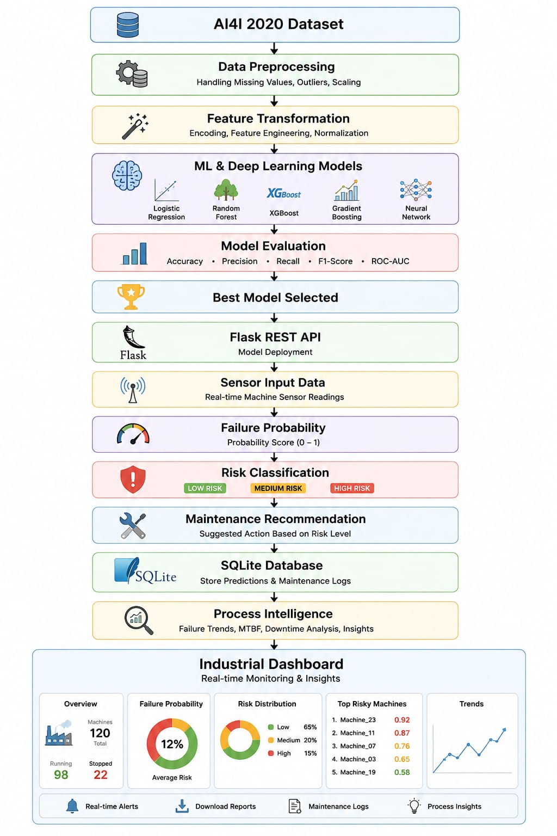
Proposed System

Slide 6
Machine Learning Methodology
Traditional Machine Learning
Logistic Regression
Decision Tree
Random Forest
Gradient Boosting
XGBoost
Deep Learning
Multi-Layer Perceptron (MLP) using PyTorch
Evaluation Metrics
Accuracy
Precision
Recall
F1-Score
ROC-AUC
Confusion Matrix

Slide 7
Model Performance
Metric | Score
Accuracy | 98.5%
Precision | 83.3%
Recall | 64.3%
F1-Score | 71.0%
ROC-AUC | 93.4%
Key Result:
98.5% Accuracy with 93.4% ROC-AUC, providing effective machine failure prediction.

Slide 8
Prediction & Risk Assessment
Machine Sensor Inputs
Machine Type
Air Temperature
Process Temperature
Rotational Speed (RPM)
Torque
Tool Wear
AI Prediction :Failure Probability (%)
Risk Classification
Failure Probability | Risk Level
0–30% | LOW
30–60% | MODERATE
60–80% | HIGH
80–100% | CRITICAL

Slide 9
Process Optimization & Analytics
Process Optimization
Failure Probability Trends
Machine Risk Distribution
Machine Variant Distribution
Average Risk by Machine Type
High-Risk Machine Alerts
Historical Prediction Analysis
Key Benefit
Transforms individual AI predictions into actionable operational insights for maintenance planning.

Slide 10
System Features & Dashboard
Dashboard Overview
Total Evaluations
Healthy Machines
At-Risk Machines
Average Failure Risk
Machine Health Gauge
Prediction
Analytics History
Process Intelligence Charts * Searchable Prediction Records
High-Risk Alerts * Prediction Audit History
Machine Risk Analysis
Sensor Input → AI Prediction → Risk Level → Recommendation

Slide 11
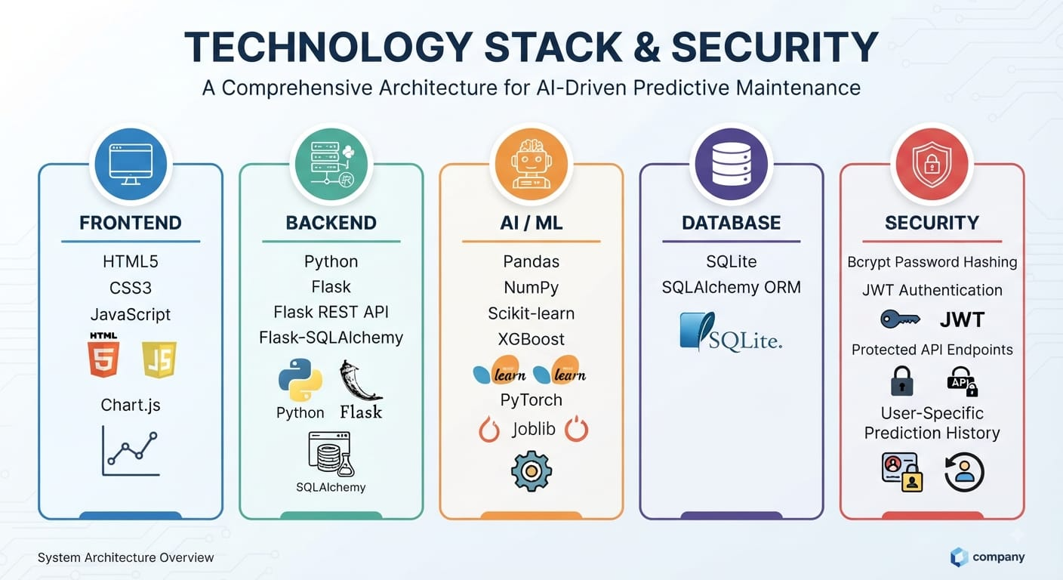
Technology Stack & Security

Slide 12
Conclusion & Future Scope
Conclusion
An end-to-end AI-Based Industrial maintenance system for early failure detection, risk assessment, and intelligent maintenance decisions.
Future Scope
Real-Time IoT Sensor Integration
Cloud Deployment
Real-Time Machine Monitoring
Automated Maintenance Scheduling
Remaining Useful Life (RUL) Prediction
ERP/CMMS Integration
Continuous Model Retraining

